Slide 1
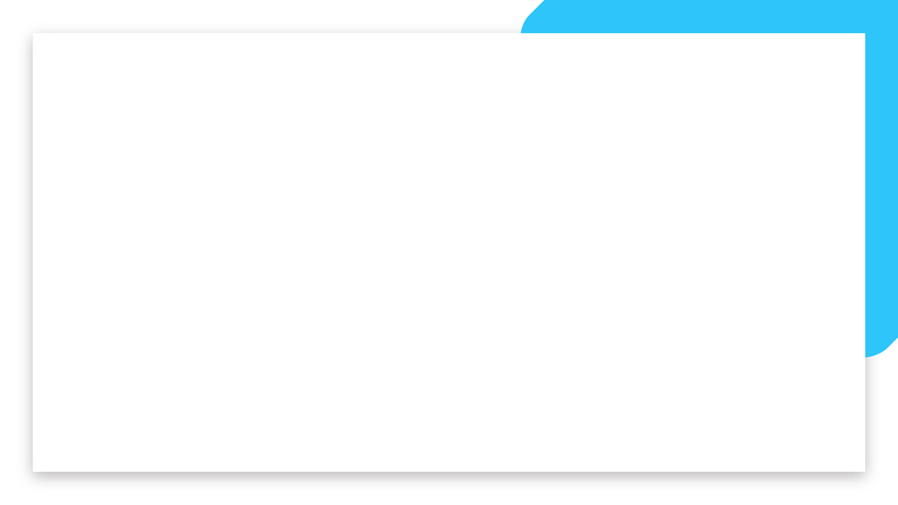


Business Challenge: EDA and SQL
Project II (Week 3)
Student: Caroline Araujo

Slide 2
The Dataset

Slide 3
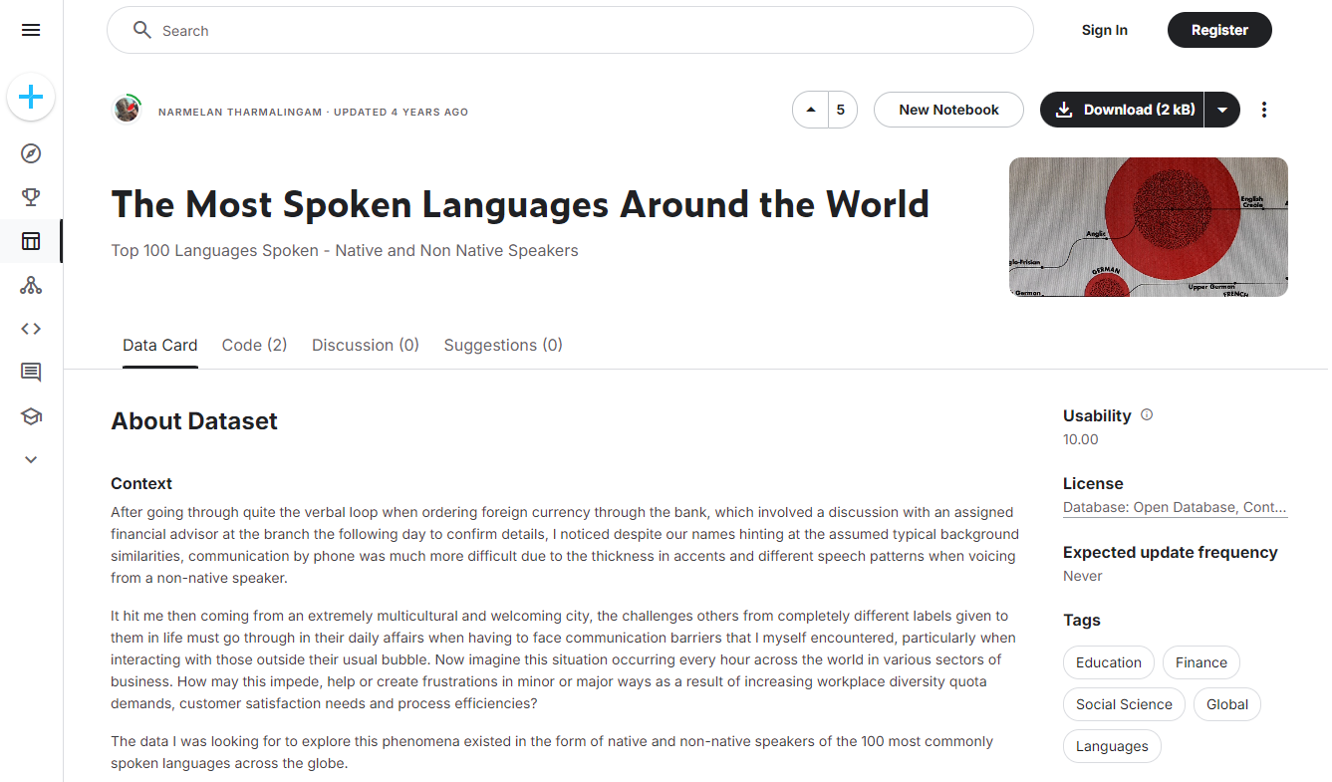
THE DATASET: OVERVIEW
➔ Extracted from Kaggle
➔ Created by Narmelan Tharmalingam
➔ Updated 4 years ago
Source: https://www.kaggle.com/datasets/narmelan/100-most-spoken-languages-around-the-world

Slide 4
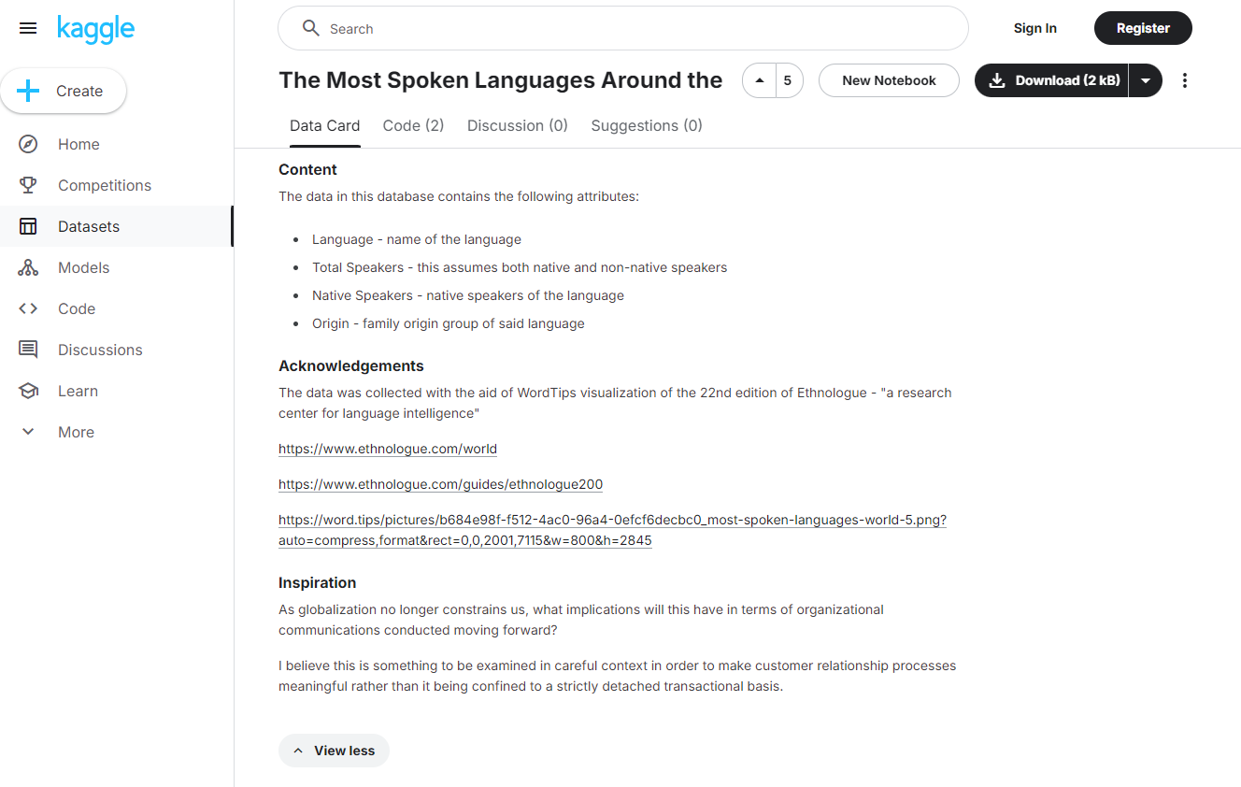
THE DATASET: CONTENT
➔ 4 Columns
➔ 101 Rows
➔ The data was collected with the aid of WordTips visualization of the 22nd edition of Ethnologue - "a research center for language intelligence"
Language
Total Speakers
Native Speakers
Origin
Source: https://www.kaggle.com/datasets/narmelan/100-most-spoken-languages-around-the-world

Slide 5
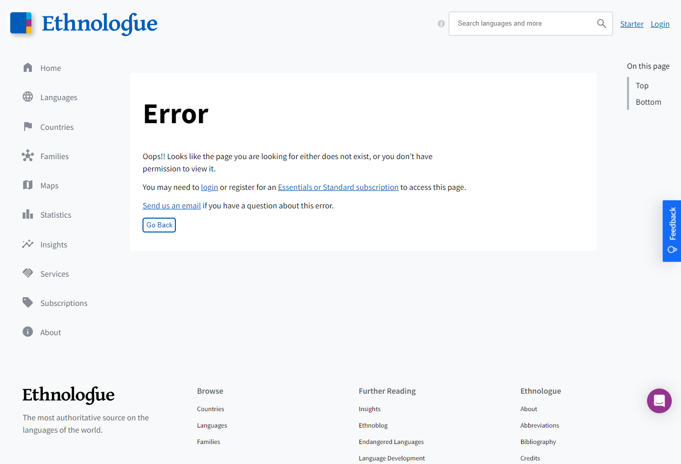
THE DATASET: CONTENT
➔ Ethnologue offers data on over 7,000 living languages, covering key aspects like:
Number of speakers
Geographical distribution
Language families
Language vitality
Source: https://www.kaggle.com/datasets/narmelan/100-most-spoken-languages-around-the-world

Slide 6
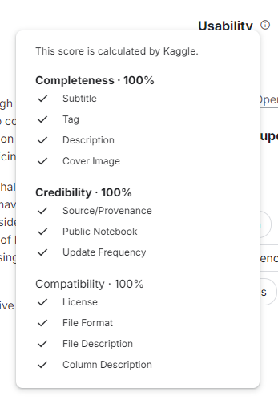

THE DATASET: USABILITY
➔ Score 10.0 in usability
Source: https://www.kaggle.com/datasets/narmelan/100-most-spoken-languages-around-the-world

Slide 7
The Code in Python

Slide 8
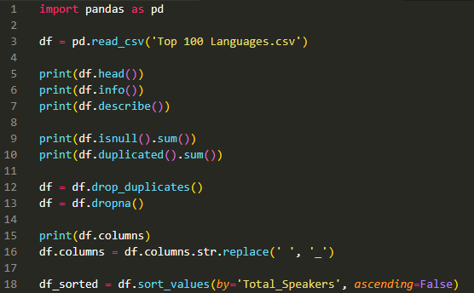
THE DATA CLEANING AND EDA
➔ Import libraries
➔ Read the data
➔ Do the EDA
➔ Clean the data
➔ Rename columns (remove spaces)
➔ Sort the data

Slide 9
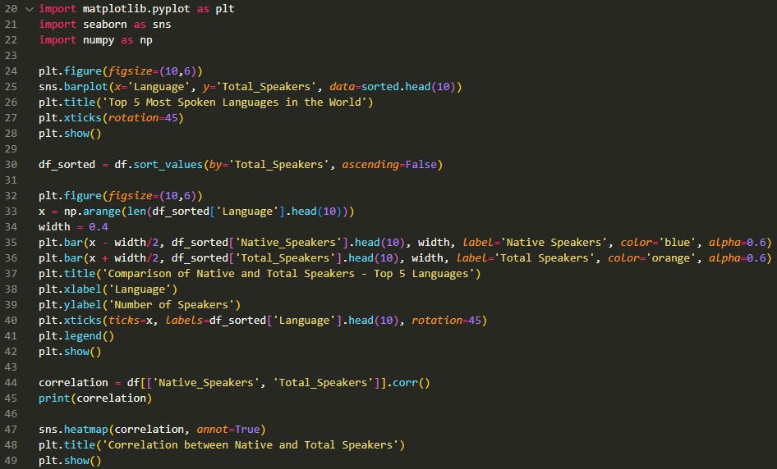
VISUALIZATION AND COMPARISON ANALYSIS
➔ Import visualization libraries
➔ Plot the top 10 languages by total speakers
➔ Make a comparison between native and total speakers for the top 10 languages
➔ Analyze the correlation analysis between native and total speakers
➔ Create a heatmap of correlation matrix

Slide 10
Visualization

Slide 11
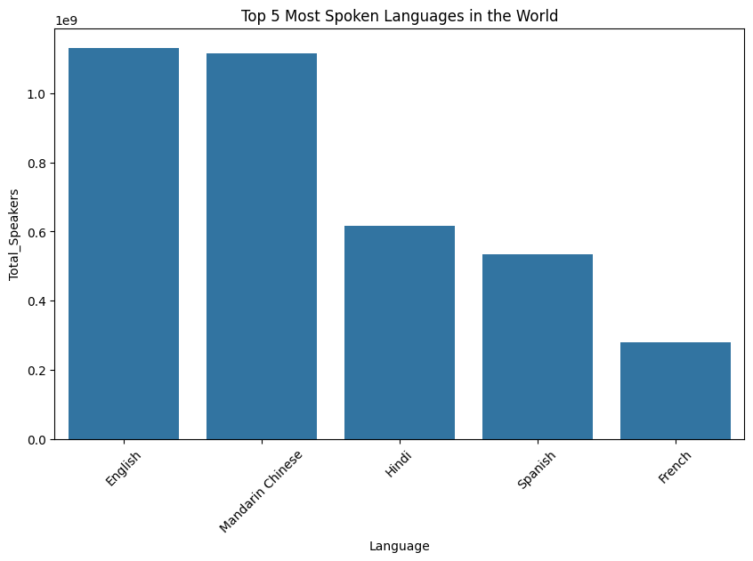

Slide 12
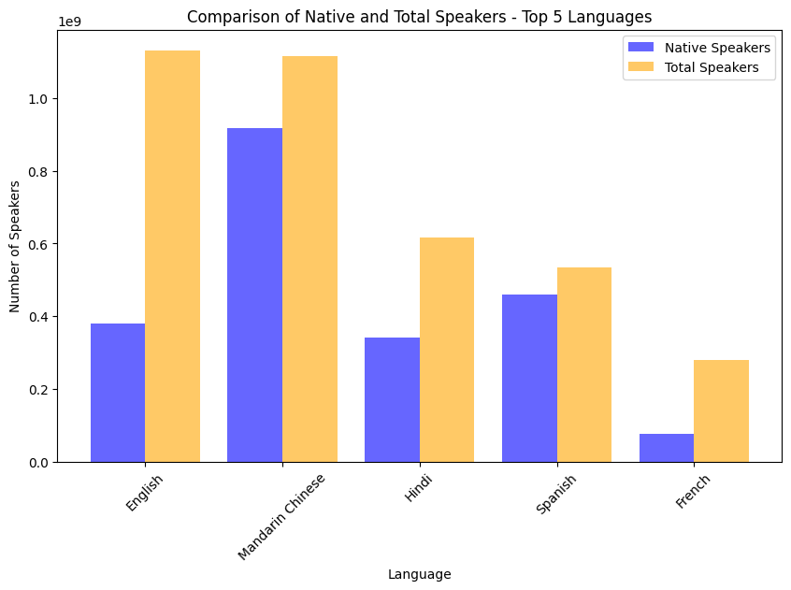

Slide 13
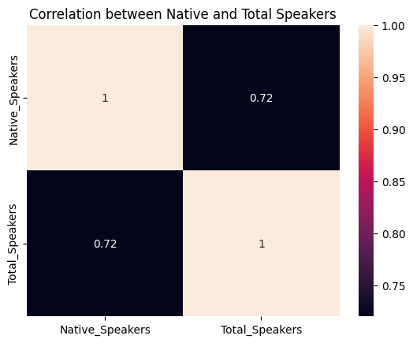

Slide 14
Business Questions

Slide 15
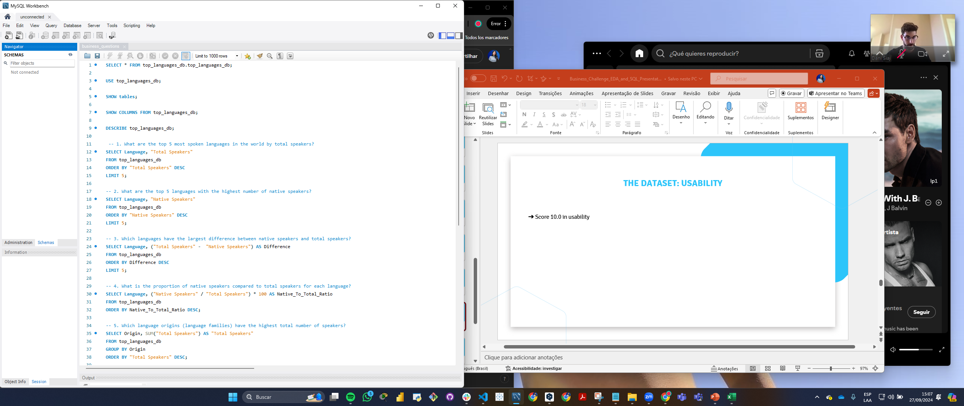
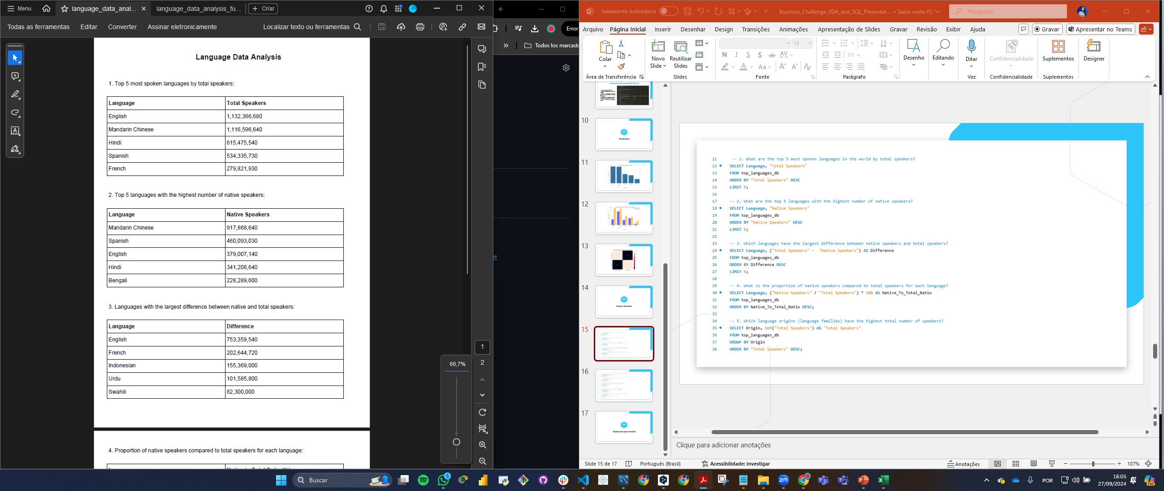
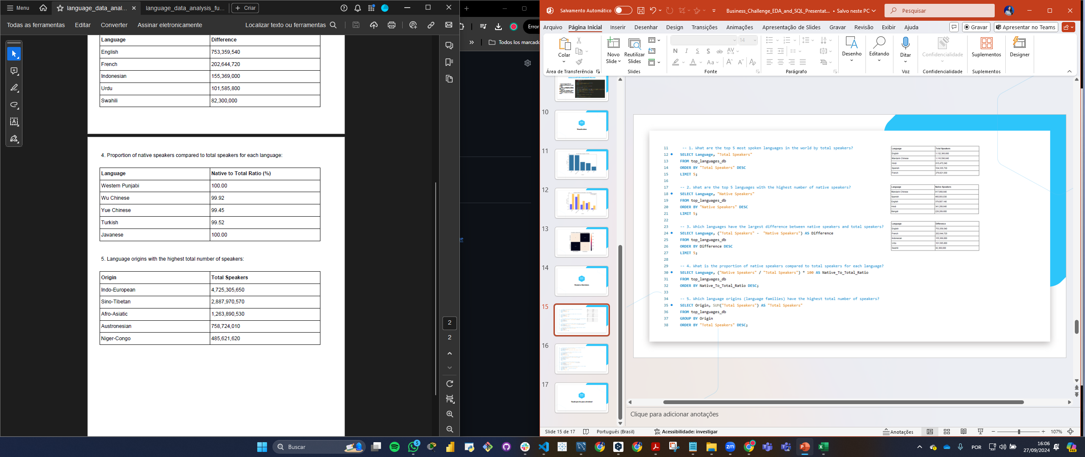

Slide 16
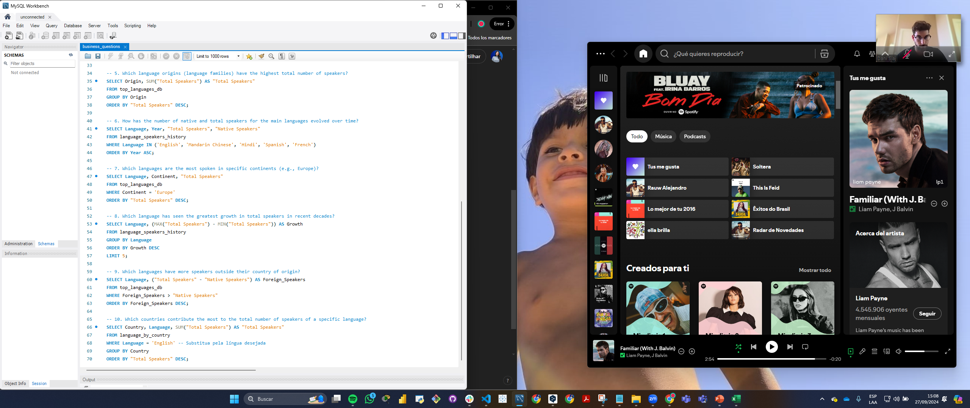

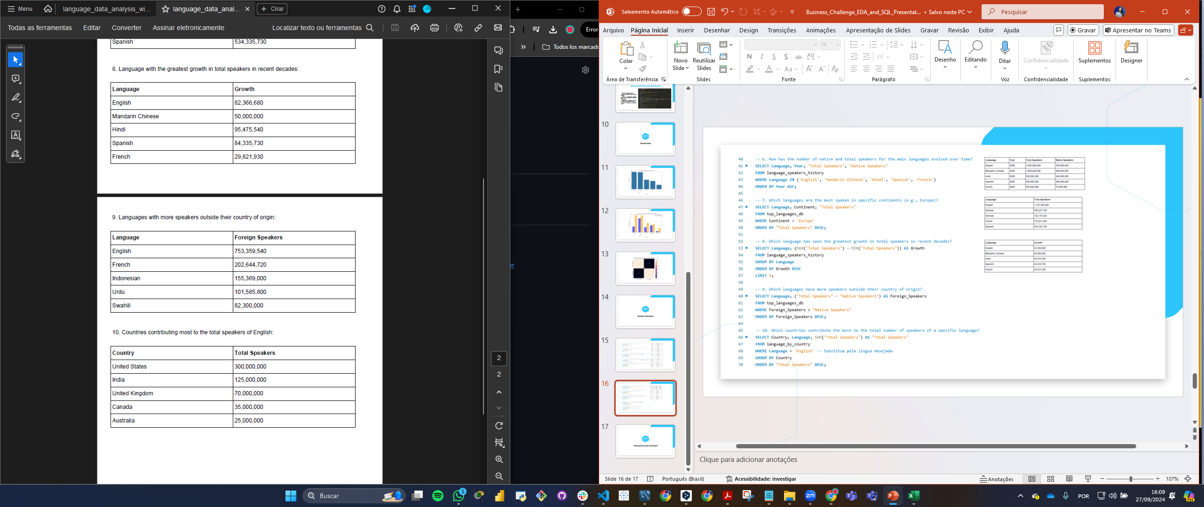

Slide 17
Thank you for your attention!

